Slide 1

SESHADRI RAO GUDLAVALLERU ENGINEERING COLLEGE Department of Computer Science and Engineering
Internship Project
On
Fake News Analysis In Social Media Using
IBM Watson
Under the guidance of
Mrs. P. Reshma, M.Tech
Assistant Professor, Department of CSE
Presented by
19481A0542 – CH SAI KUMAR
19481A0534 – CH SAJAN
19481A0516 – B HIMA KRISHNA
19481A0520 – B BALA SAI

Slide 2
CONTENTS
ABSTRACT
OBJECTIVE
EXISTING SYSTEM
PROPOSED SYSTEM
ARCHITECTUE
METHODOLOGY
REQUIREMENTS
IMPLEMENTATION
OUTPUT

Slide 3
ABSTRACT
In our modern era where the internet is being everywhere at the same time, everyone relies on various online resources for news.
Along with the increase in the use of social media platforms like Facebook, Twitter, etc. News spread rapidly among millions of users within a very short span of time.
The spread of fake news has for reaching consequences like the creation of biased opinions.
Moreover, spammers use appealing news headlines to generate revenue using Advertisements. We aim to provide the user with the ability to classify the news as fake or real.

Slide 4
OBJECTIVE
The objective is to object the fake news by using Algorithm and to build a model that can differentiate between "Real" Fake" news.
By using Natural Language Processing(NLP) we can classify the data.
Using NLP, at the end we can make website using Flask framework.

Slide 5
EXISTING SYSTEM
Existing system model is not that accurate in results.
It is a static type model not dynamic model i.e, it only works for news present in current data set.
We need to update data set of news in order to get latest news.
It takes more time for loading and processing the data set when we updates to the new data set.

Slide 6
PROPOSED SYSTEM
By using NLP we can identify the Whether the news “fake” or “real”.
In this model is build based on the tfidf matrix i.e, word tallies relatives to how often they are used in other articles in your dataset can help.
Extract the most optimal features for tfidf-vectorizer, this is done by using a n-number of the most used words, and/or phrases, lower casing or not, mainly removing the stop words which are common words such as “the”, “when”.

Slide 7
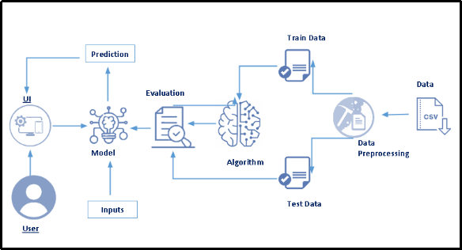
ARCHITECTURE
Technical Architecture

Slide 8
METHODLOGY
These are the steps to be followed to build the model are
1. Data Collection
2. Testing the model and Training the model.
3. Model Building
4. Application Building
By using Flask framework, we can build the website.

Slide 9
REQUIREMENTS
Jupyter Notebook
Spyder
Python
-Flask Framework
HTML-(Hyper Text Markup Language)

Slide 10
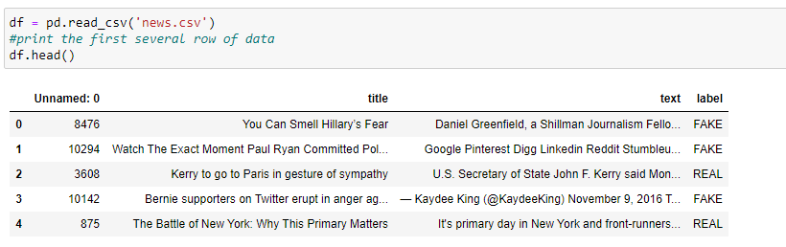
IMPLEMENTATION
The proposed system is implemented using Jupyter Notebook and Flask. Steps included in this implementation are Data gathering, Vectorizers, model training and prediction.
The data set consists in .csv format.

Slide 11
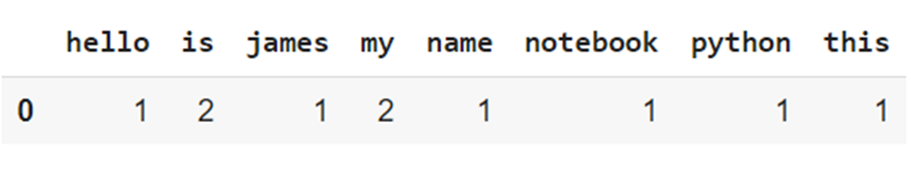
TESTING THE MODEL
Count vectorizer
Count vectorizer is a method to convert text to numerical data.
Example:
Text=[Hello my name is james, this is my python notebook]
The test is transformed to a parse matrix as shown below.

Slide 12
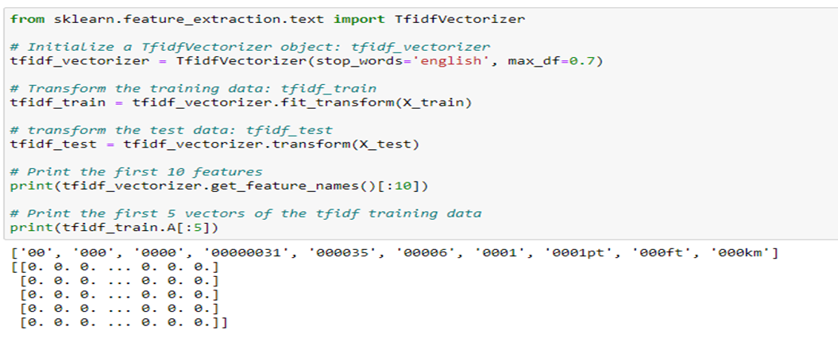
TRAINING THE MODEL​
Tf-idf vectorizer
To perform machine learning on text, we need to transform our documents into vector representations such that we can apply numeric machine learning.

Slide 13

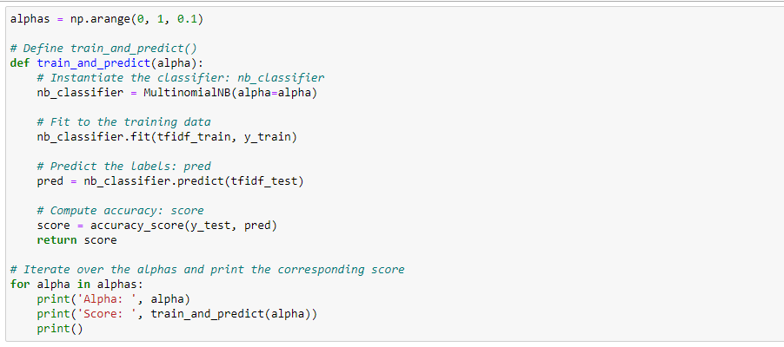
MODEL CREATION
Steps to be followed for Model Building
1.Spliting the data into Train and Test
2. Simple NLP, Complex Problems

Slide 14
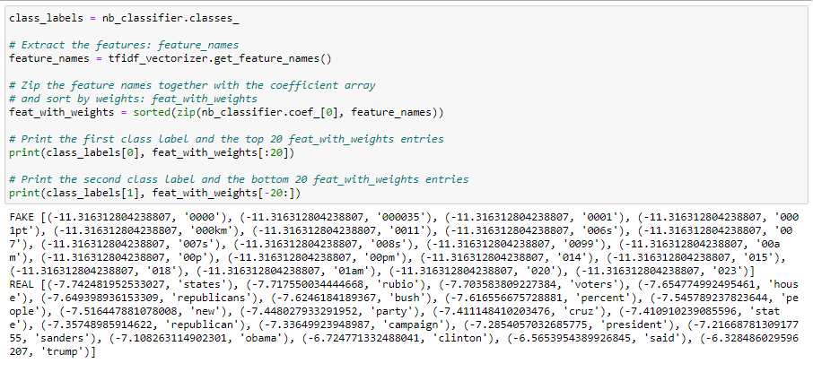
TEST THE MODEL
3.Inspecting our model

Slide 15
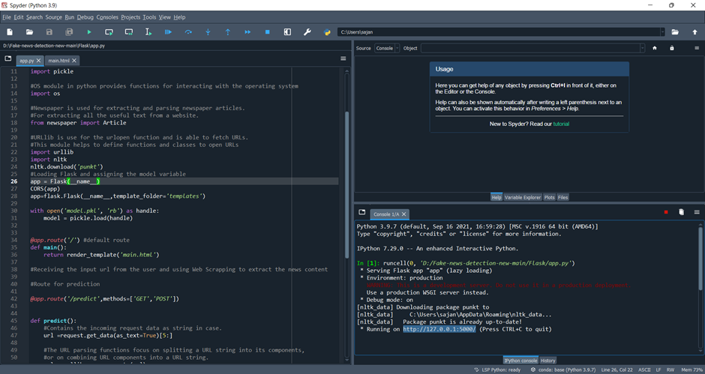
DEPLOYMENT
Deploy the model into Flask by using Spyder.

Slide 16
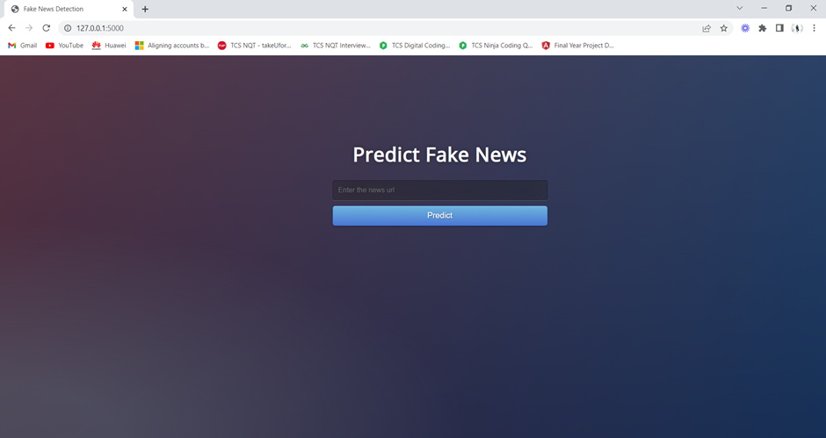
Webpage of the application

Slide 17
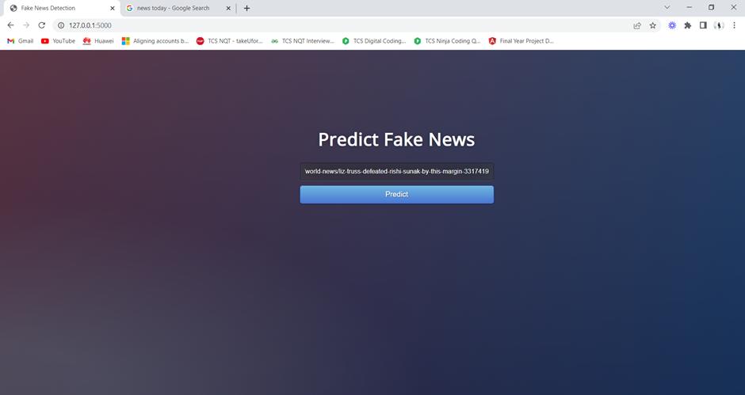
2. Enter the news of the URL

Slide 18
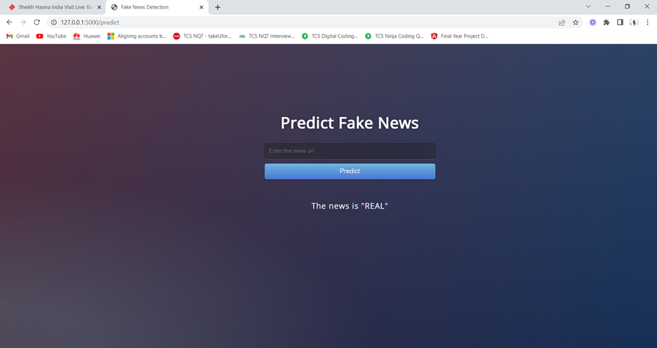
OUTPUT

Slide 19
THANK YOU

